Slide 1
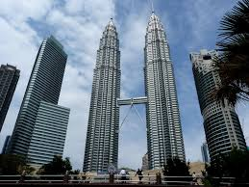
REDEFINING BUSINESS MODEL IN POST COVID -19
PROF DR JUHARY ALI
SCHOOL OF MANAGEMENT
ASIA e UNIVERSITY
MALAYSIA

Slide 2
PANDEMIC COVID-19 MOVEMENT CONTROL ORDER (MCO)
AVOID 3S
CROWDED PLACES
CLOSE CONTACT SETTING
CONFINED AND ENCLOSED SPACES
OBEY 3W
WASH HAND
WEAR MASK
WARN FROM THE MINISTRY OF HEALTH

Slide 3
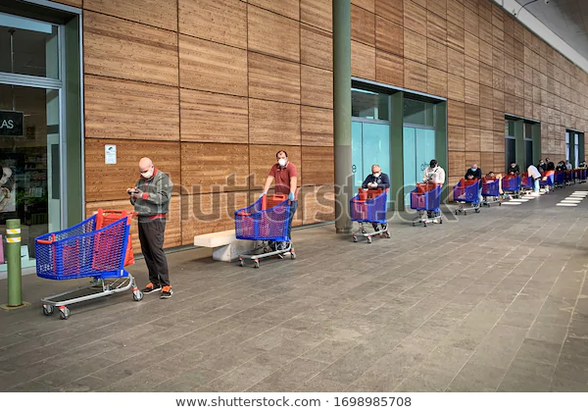

Slide 4
BUSINESS MODEL Value Proposition FIT MARKET (customer profile)

Slide 5
Value Proposition: positioning around customer value and needs
Firm’s Value Proposition
Customer Profile of each market segment
Product and Services
Gain Creator
Pain Reliever
Alexander Osterwalder et al. (2015) Value Proposition Design.Wiley
Customer job
Customer gain
Customer pain

Slide 6
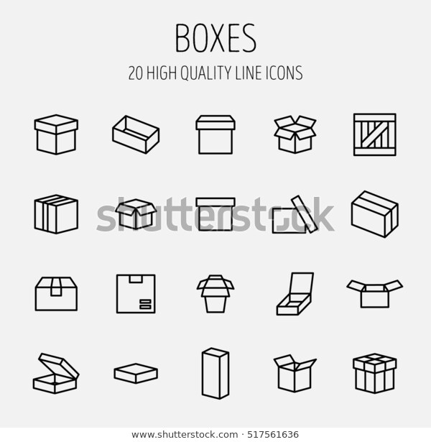
STRATEGIC RENEWAL
REDESIGN BUSINESS ACTIVITIES
VALUE CHAIN
VALUE NETWORK
SUPPLY CHAIN
PRODUCT MIX
MARKETING MIX
REVENUE MODEL

